Slide 1

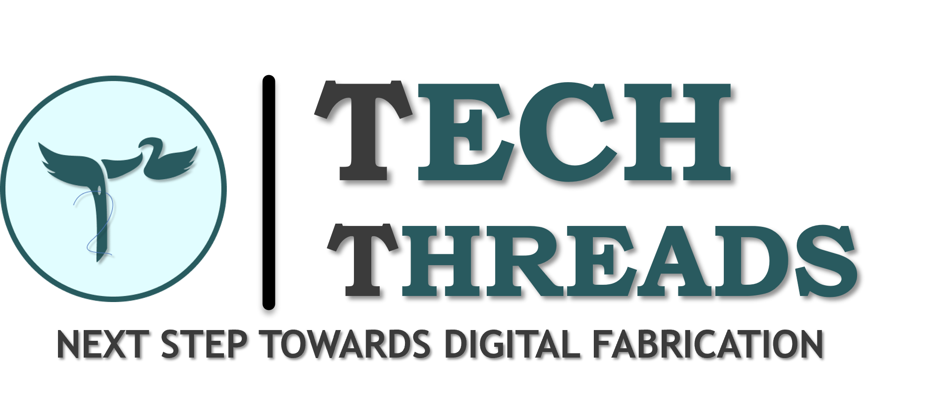




Slide 2
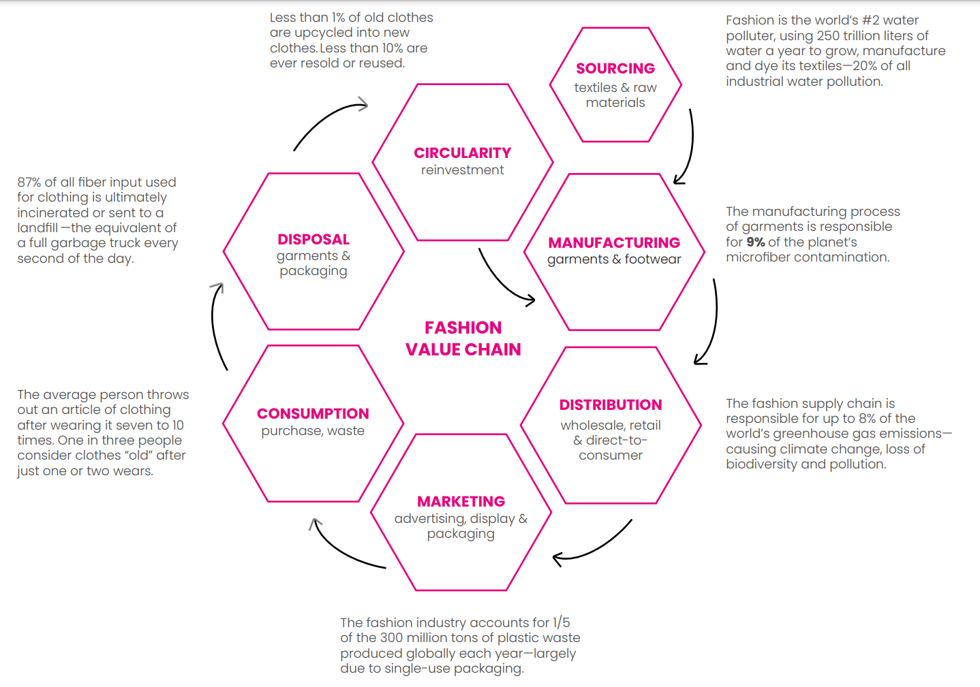
PROBLEMS IN TODAY’S TEXTILE INDUSTRY
As we all know, today’s apparel industry is not sustainable. Each stage of it’s value chain is harmful to both people and planet.
In fact, fashion is world’s second-most polluted industry.

Slide 3
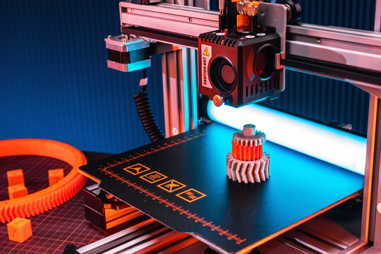
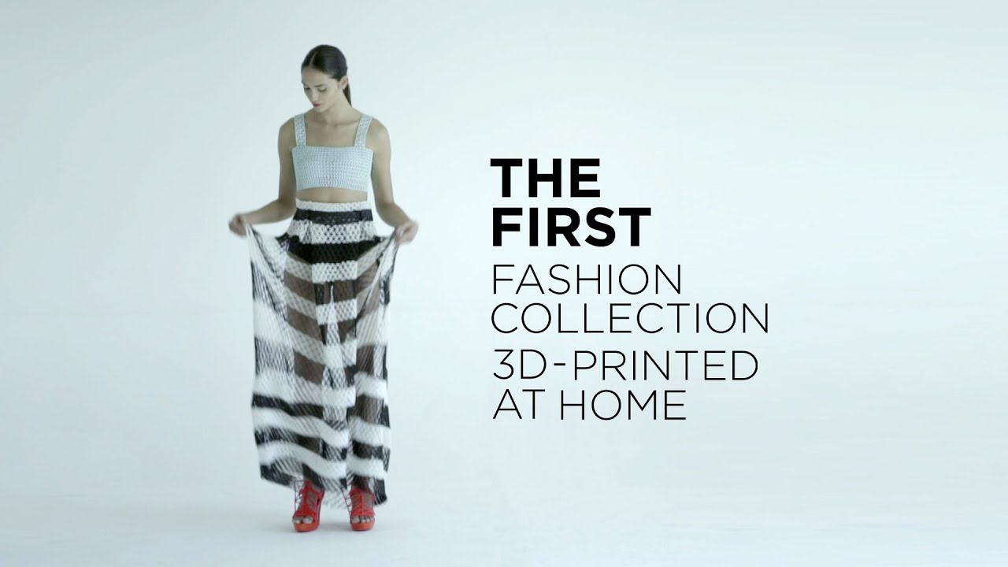
WHAT EXACTLY IS 3D PRINTING?
3-D printing technology is considered as one of the most emerging and significant technology of the upcoming revolution in the fashion industry.
One can use 3D printing technology in fashion to design accessories, build prototypes and manufacturing tools , boost towards sustainability efforts and expand customization options.

Slide 4
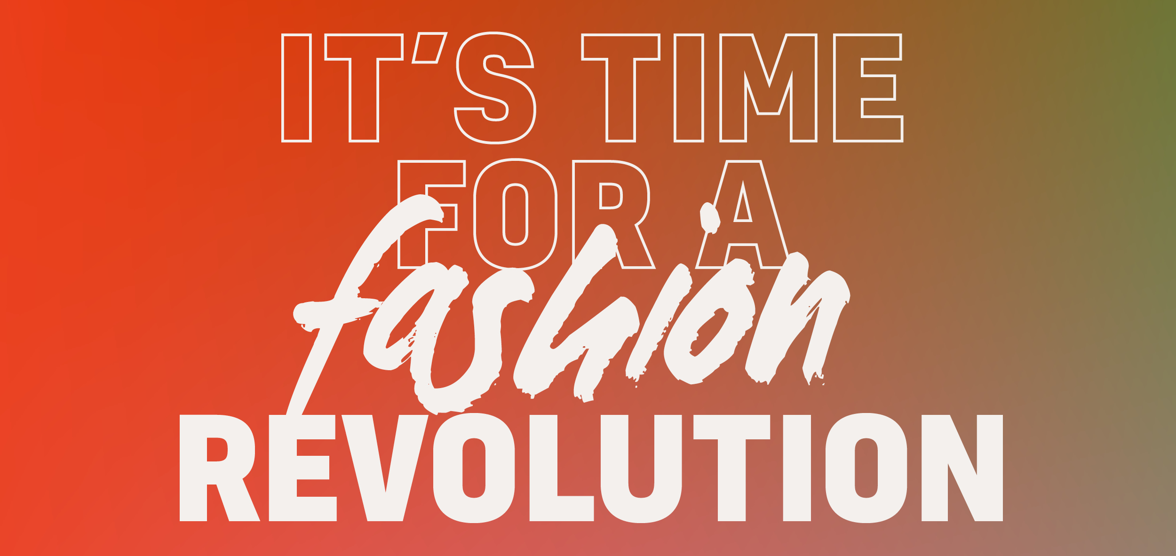
OUR GOALS AND VISIONS
What we aspire to do?
We are revolutionizing the fashion industry by making clothes that are not only unique, highly creative and have a great opportunity of personalization but also which are affordable, sustainable and environment friendly.
How we should do it?
By using advanced technologies such as 3-D printing technology.
Why we do it?
To solve the problems today’s textile industry is facing and to create a better world for our future generations.

Slide 5

HOW DOES OUR SYSTEM WORK?
Showcasing Digital designs or prototypes
Old products will be used as filaments and would then be converted to clothes.
Customers choose their designs
Our Website
Start manufacturing their chosen designs
After usage collecting the used product by giving the customer digital credits which they might use to buy new clothes or make a new cloth out of their old ones
Taking digital measurements of the customer
Delivery to the customer

Slide 6
OUR FINANCIAL STRATEGY
Expenditure
3D printers
Manufacturing costs
Employees
Maintenance
Delivery variable
Operational costs
Marketing
Filaments
Revenue
Selling the clothes
Subscriptions for exclusive designs
Using recycled filaments
Cash In
Cash Out
Net Profit
Our supply chain is responsive, which prevents over production and consumes less storage.
It is as responsive as required, as efficient as possible.

Slide 7

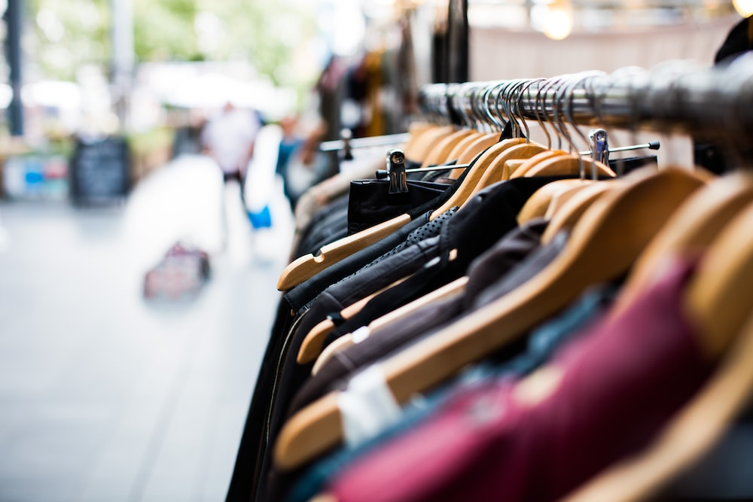
OUR MARKETING STRATEGY
Target Customers:
16 – 28 years
Primary
Film Industry
Fashion Shows
Influencers
Audience (Middle & Upper-middle class)

Slide 8
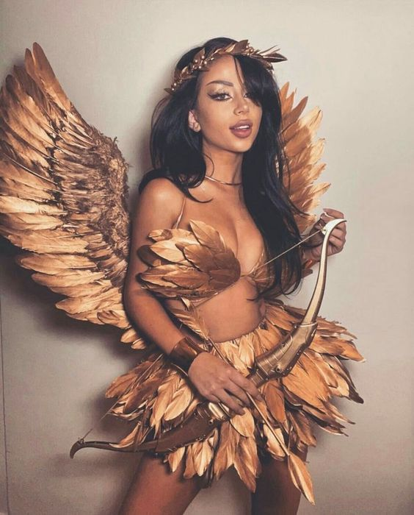
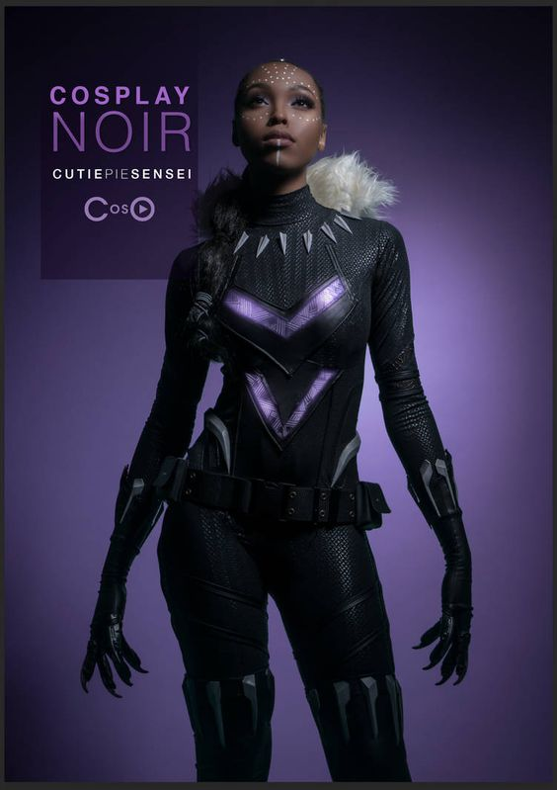
Continued…
Strategy for marketing:
Exclusive previews
Showcasing as a sustainable and durable product through memes
Google and Facebook ads
Social Media posts
Virtual events
Introductory offers
Building a premium brank look
Giving credits to customer when we will collect the sold clothes, which they can use to buy new ones
Doing a social media event where we will take designs and choose top 3 and send the clothes with their design back to them

Slide 9
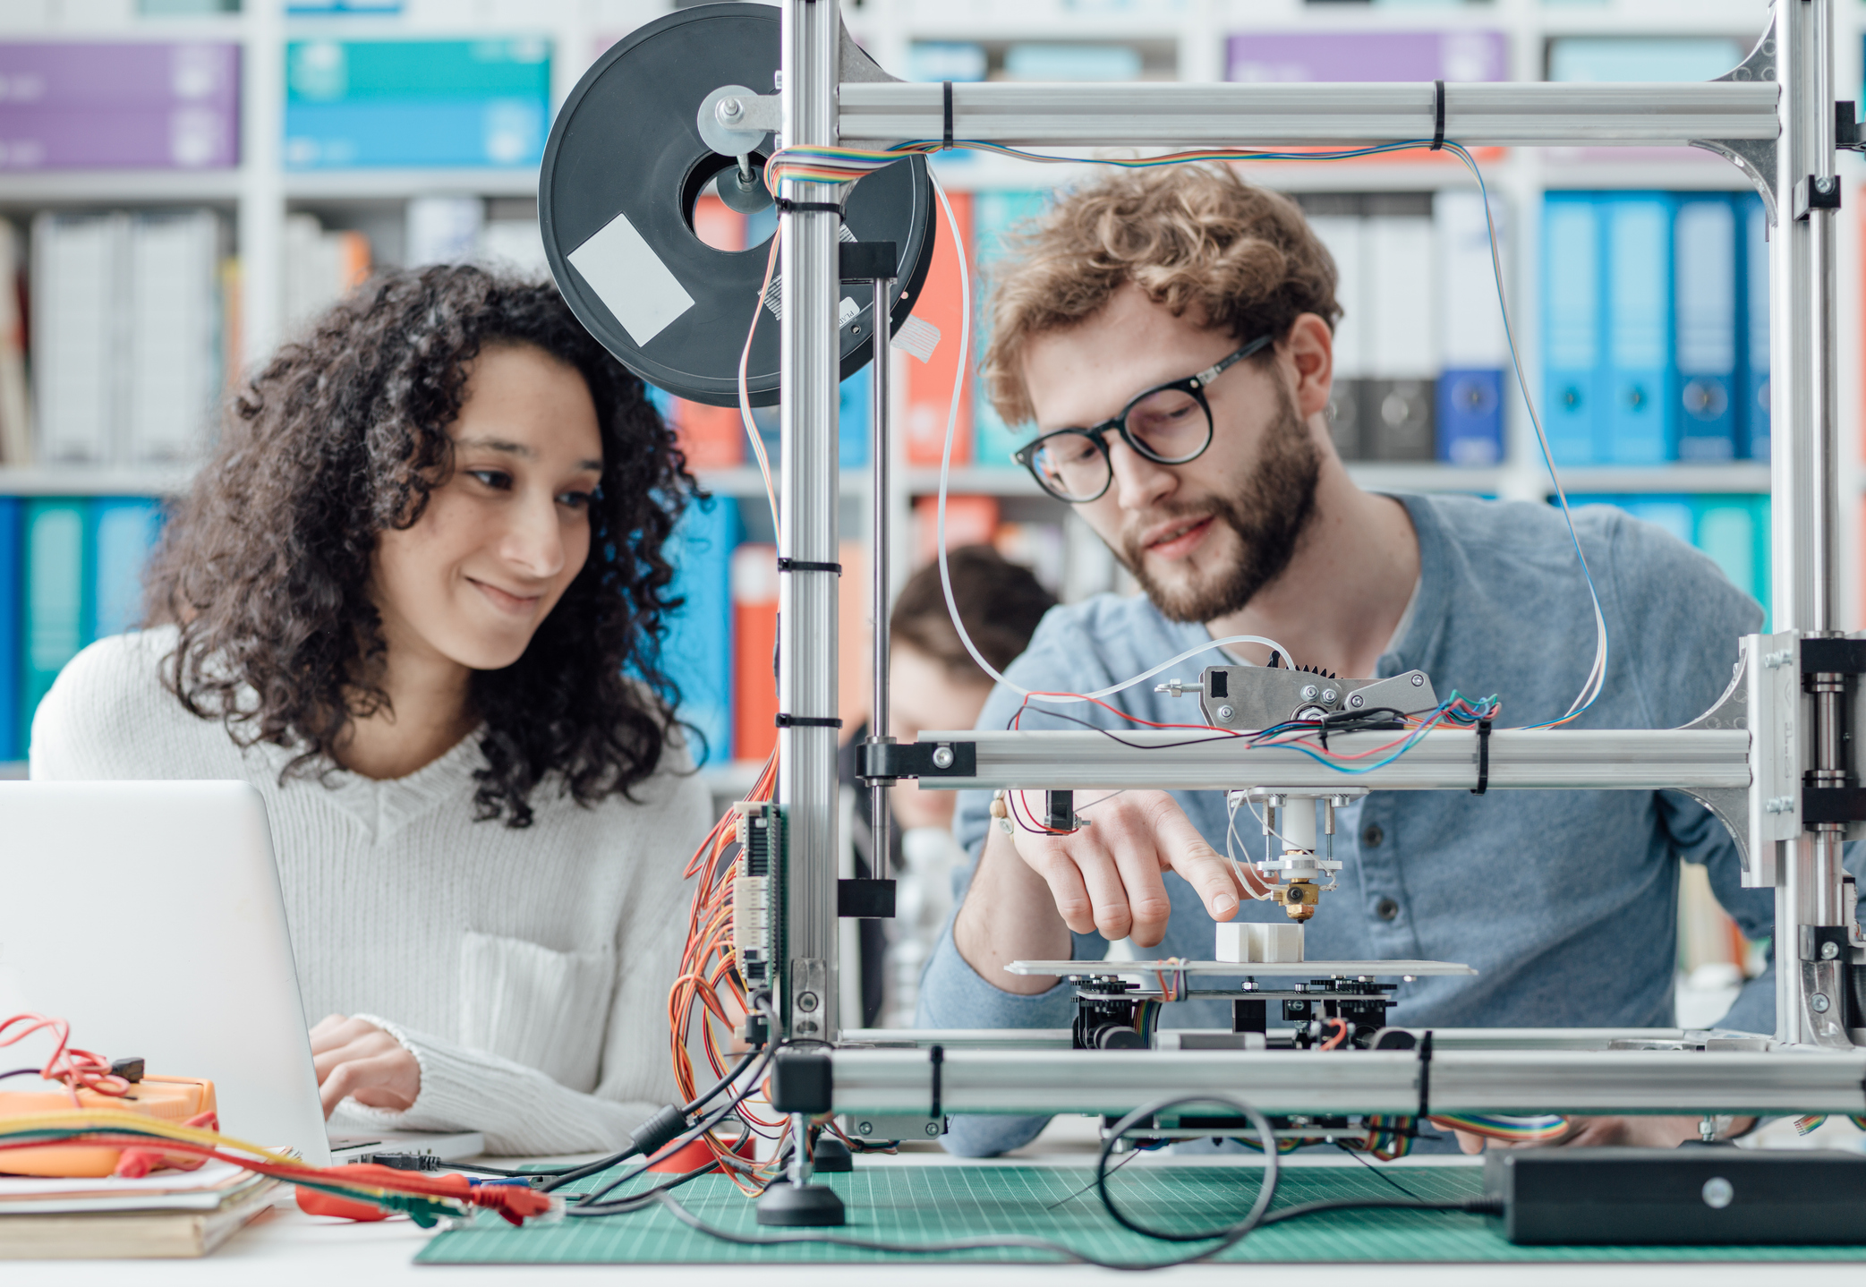
EMPLOYMENT SCOPES
Technical Positions
Software Engineers
Textile Engineers, etc.
Other Positions
There will be a big team of delivery & supervising crew.
Designer Positions
Fashion Designers
Textile Designers, etc.
Development Positions
Product Developers
Technical Developers, etc.
Sales Positions
Sales Associates
Merchandizers, etc.

Slide 10
WHY US?
Pre – T^2 | Post – T^2
Wastage of clothes/products due to market risks or change in trends | Prevent over production
Design → Produce → Sell | Design → Sell → Produce
A lot of shipping fees invested | Sending designs by digital files to our company’s other branches. So, no shipping fee
Microfibres dumped into water bodies causing water pollution. | Mostly recyclable. No microfibres dumped into water bodies
Huge textile waste after the cutting process | No textile/fabric waste after cutting process

Slide 11
Continued…
Pre – T^2 | Post – T^2
Not vegan, animal cruelty | Vegan, no animals are harmed in the making process
Huge portion of land needed for production (i.e., cotton, jute etc.) | No land needed for production of raw material
Not individually involved | Supporting individuality by customization / personalization.
Does not support work from home, i.e., have to meet customers physically | Supports work from home, i.e., does not have to meet customers physically

Slide 12
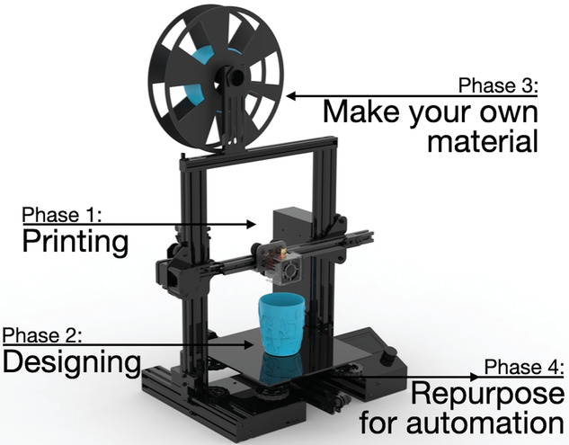
OUR FIRST STEP
Consult with qualified professionals
Above-average understanding of market
Identify community competitors and their business
Familiarize with current cloth costs
Start the production of the ordered designs

Slide 13

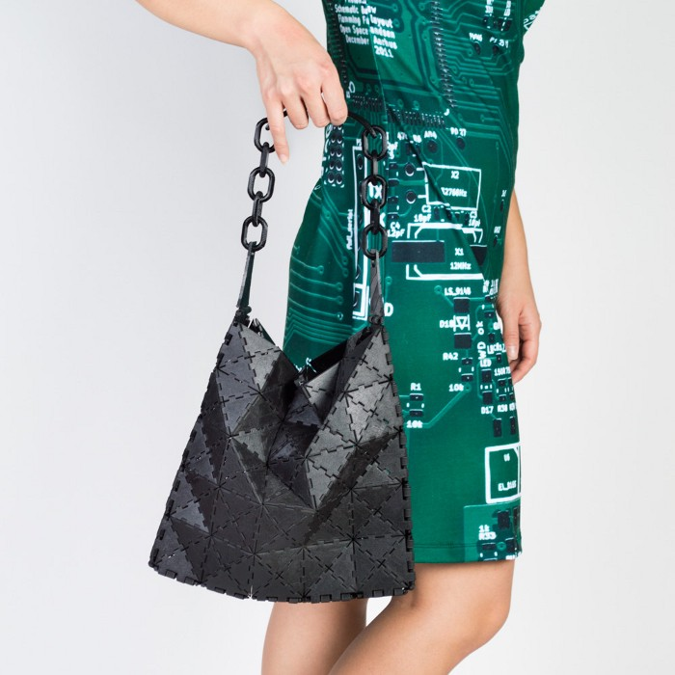
OUR FUTURE PLANS
Introducing AI in our business
Making clothes more affordable and comfortable
Investing in research & development
Globalized market
Creating accessories, bags etc rather than just clothes.

Slide 14
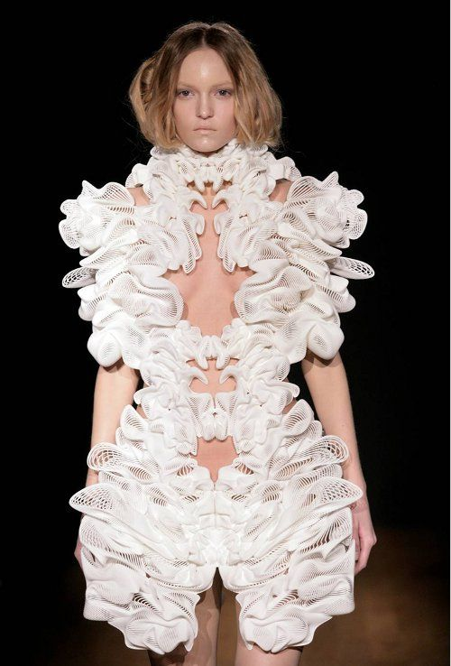
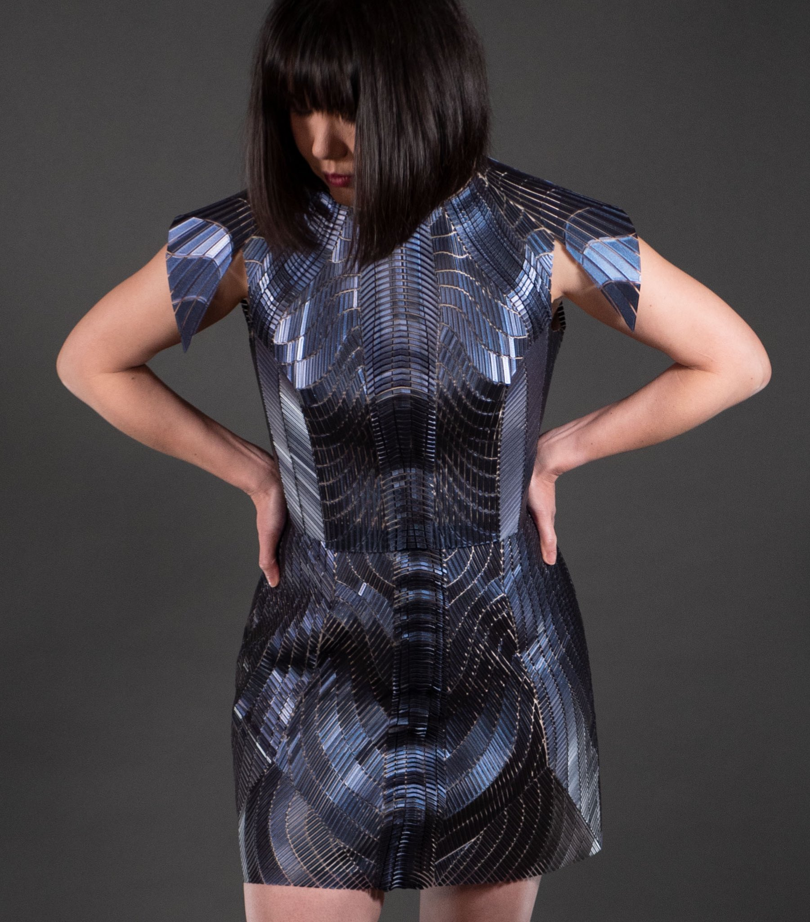
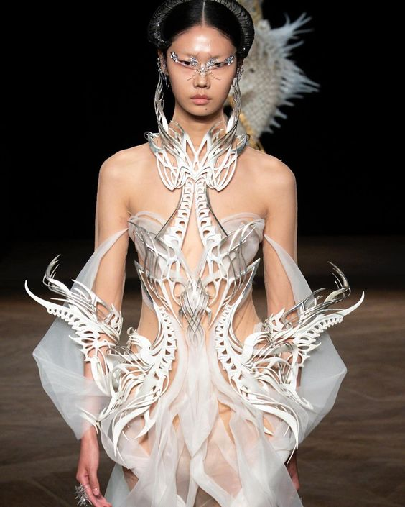
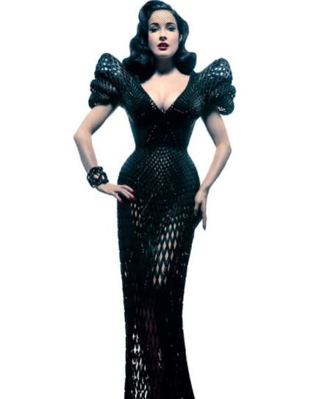
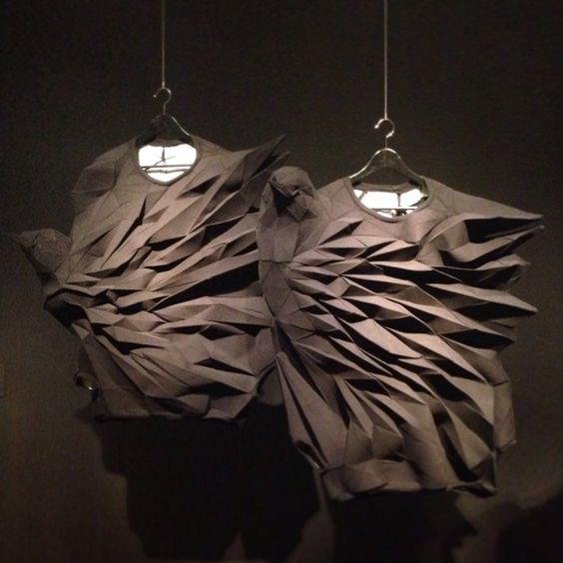
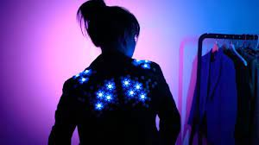
3D PRINTED CLOTHES

Slide 15
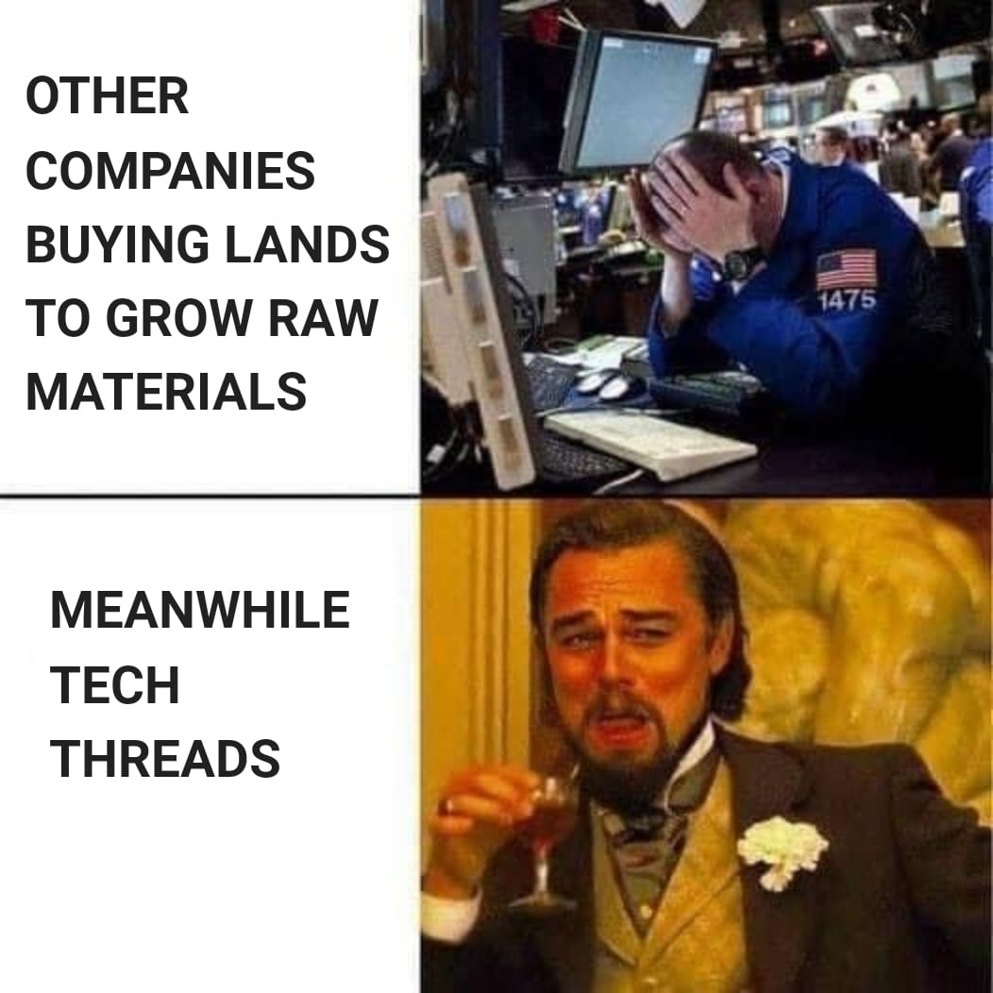
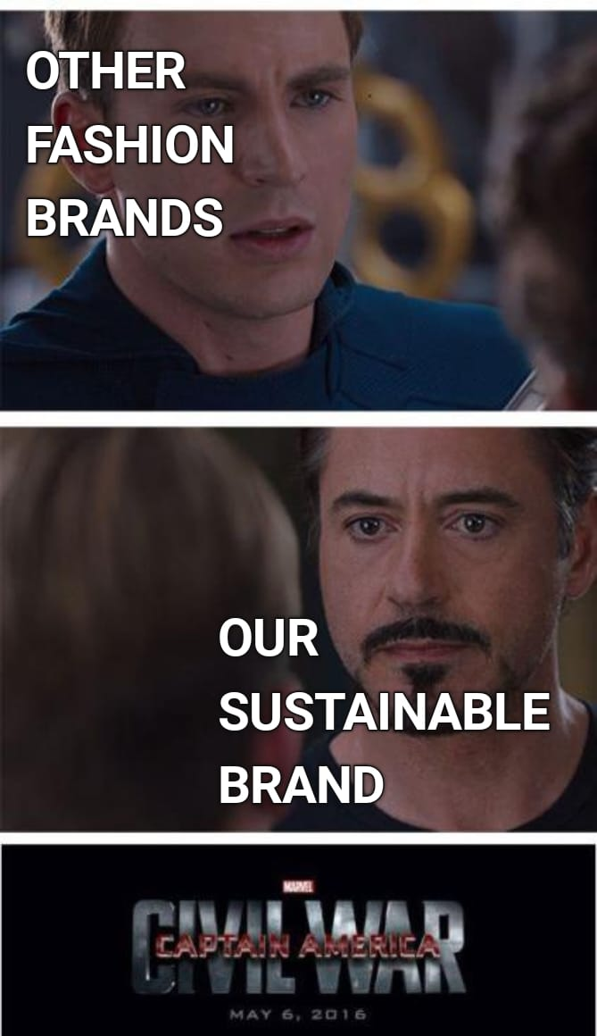
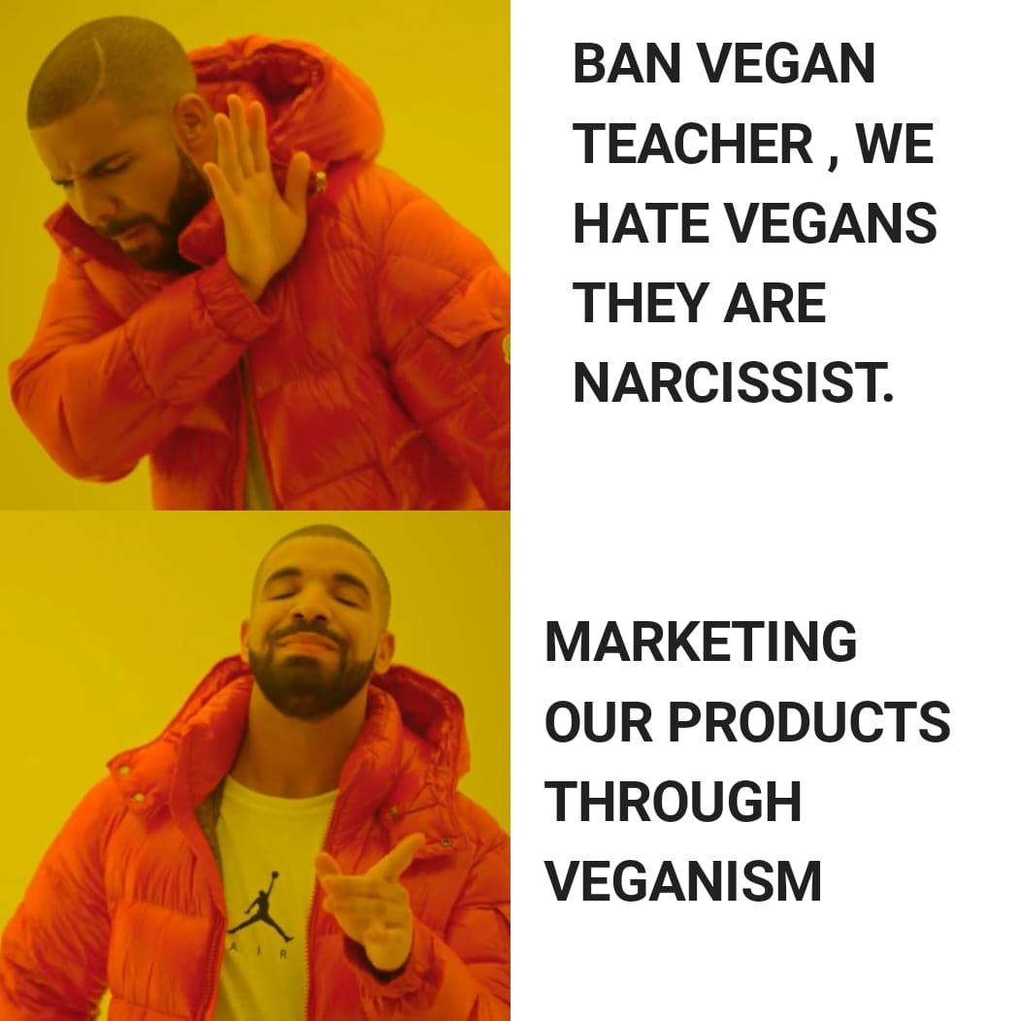
OUR UNIQUE WAY OF MARKETING

Slide 16



CONCLUSION
Creating unique sustainable clothes while taking care of our mother nature.
Less water pollution, no animal cruelty, no wastage, huge amount of lands being conserved while making profile.
Creating employment scopes.

Slide 17
WISHES A SPECIAL
THANK YOU !

